Slide 1
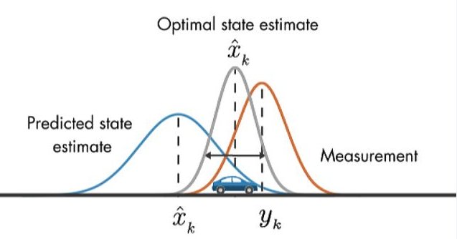
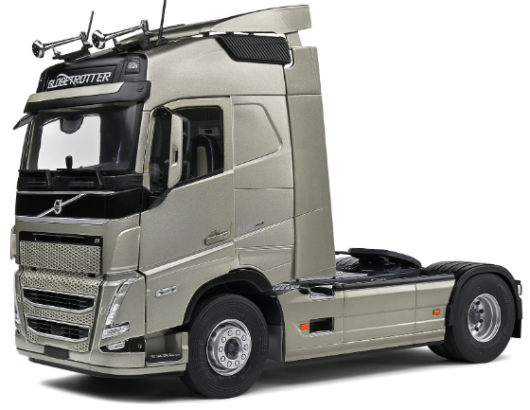
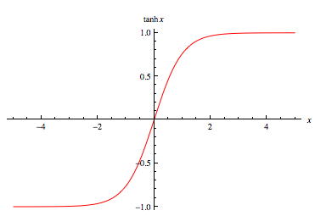
Extended Kalman Filter
Uplevel controller (MPC)
States
Lidar
Steering
Process Propagation
Position
Constraints
IMU
Velocity
Measurement Update
Heading Angle
MPC Controller
GPS
Target State
Throttle/Brake
Longitudinal Control
Measurement
Lateral Control
Steering
Local controller (PID)
Scaled by tanh(x)

Slide 2
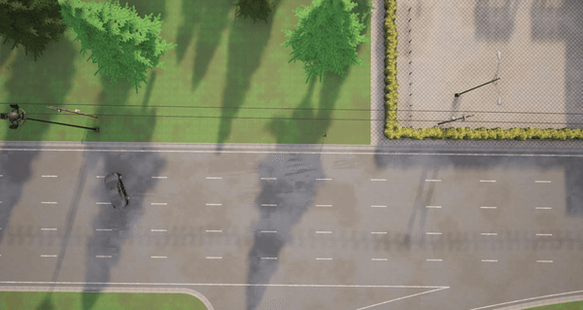
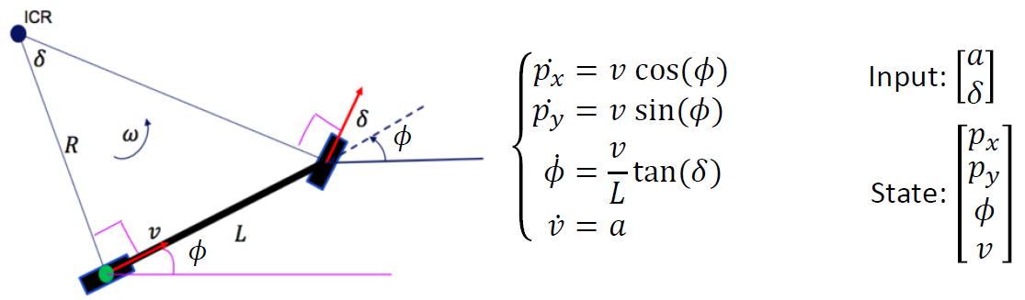
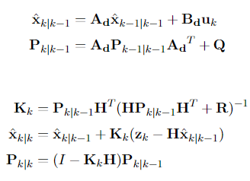
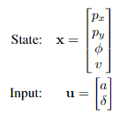
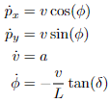
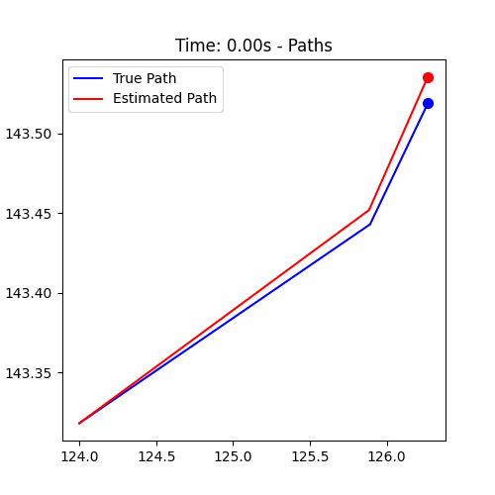
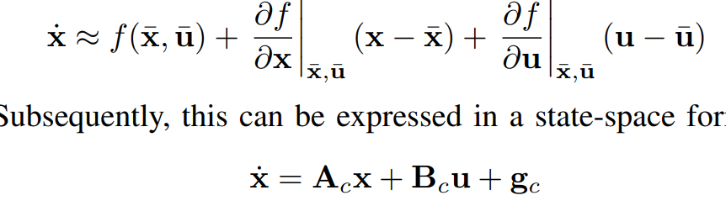
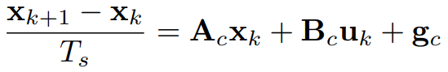
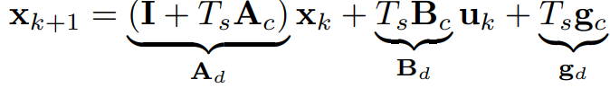
Process Model(Using LTV Model)
Extended Kalman filter
Process Predict(Kalman filter)
Measurement Update(Kalman filter)
H is Identity matrix
Stationary P is sued to calculate tighten bound

Slide 3
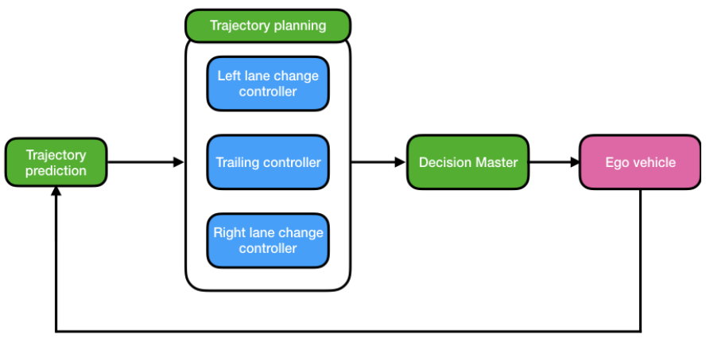
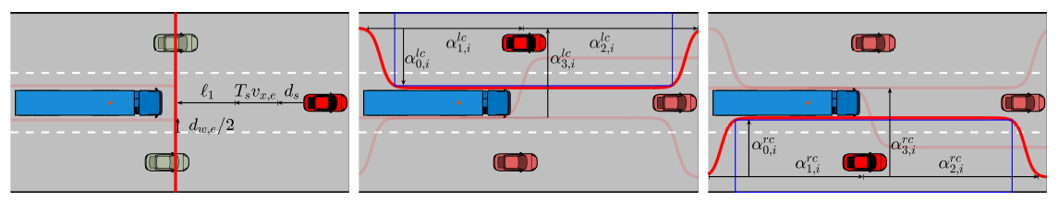
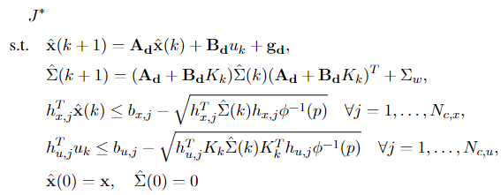
RMPC Controller Architecture
Trailing controller
Left lane change controller
The highway autopilot uses a trajectory planner and three predictive controllers for trailing and lane changes, employing vehicle prediction to optimize trajectories via a Decision Master.
Right lane change controller

Slide 4
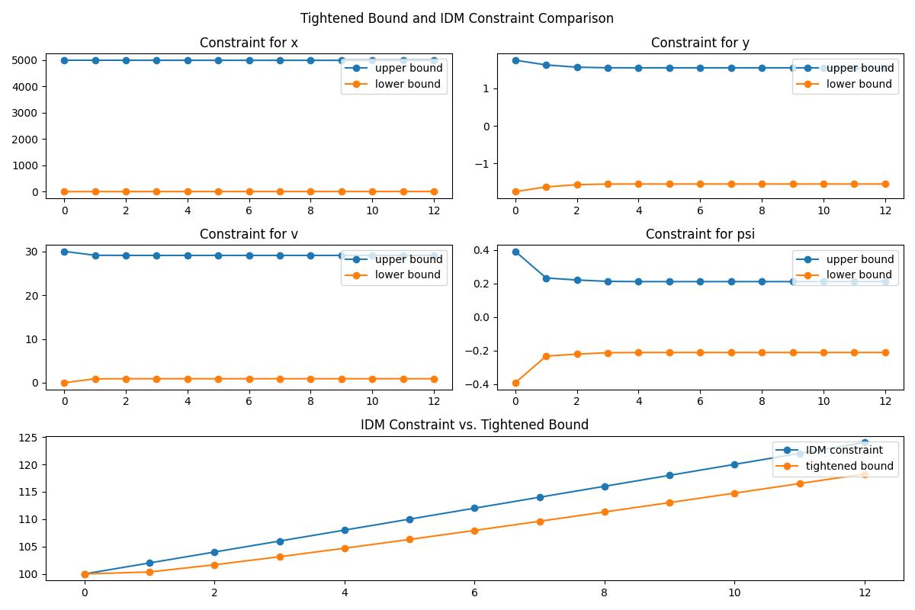
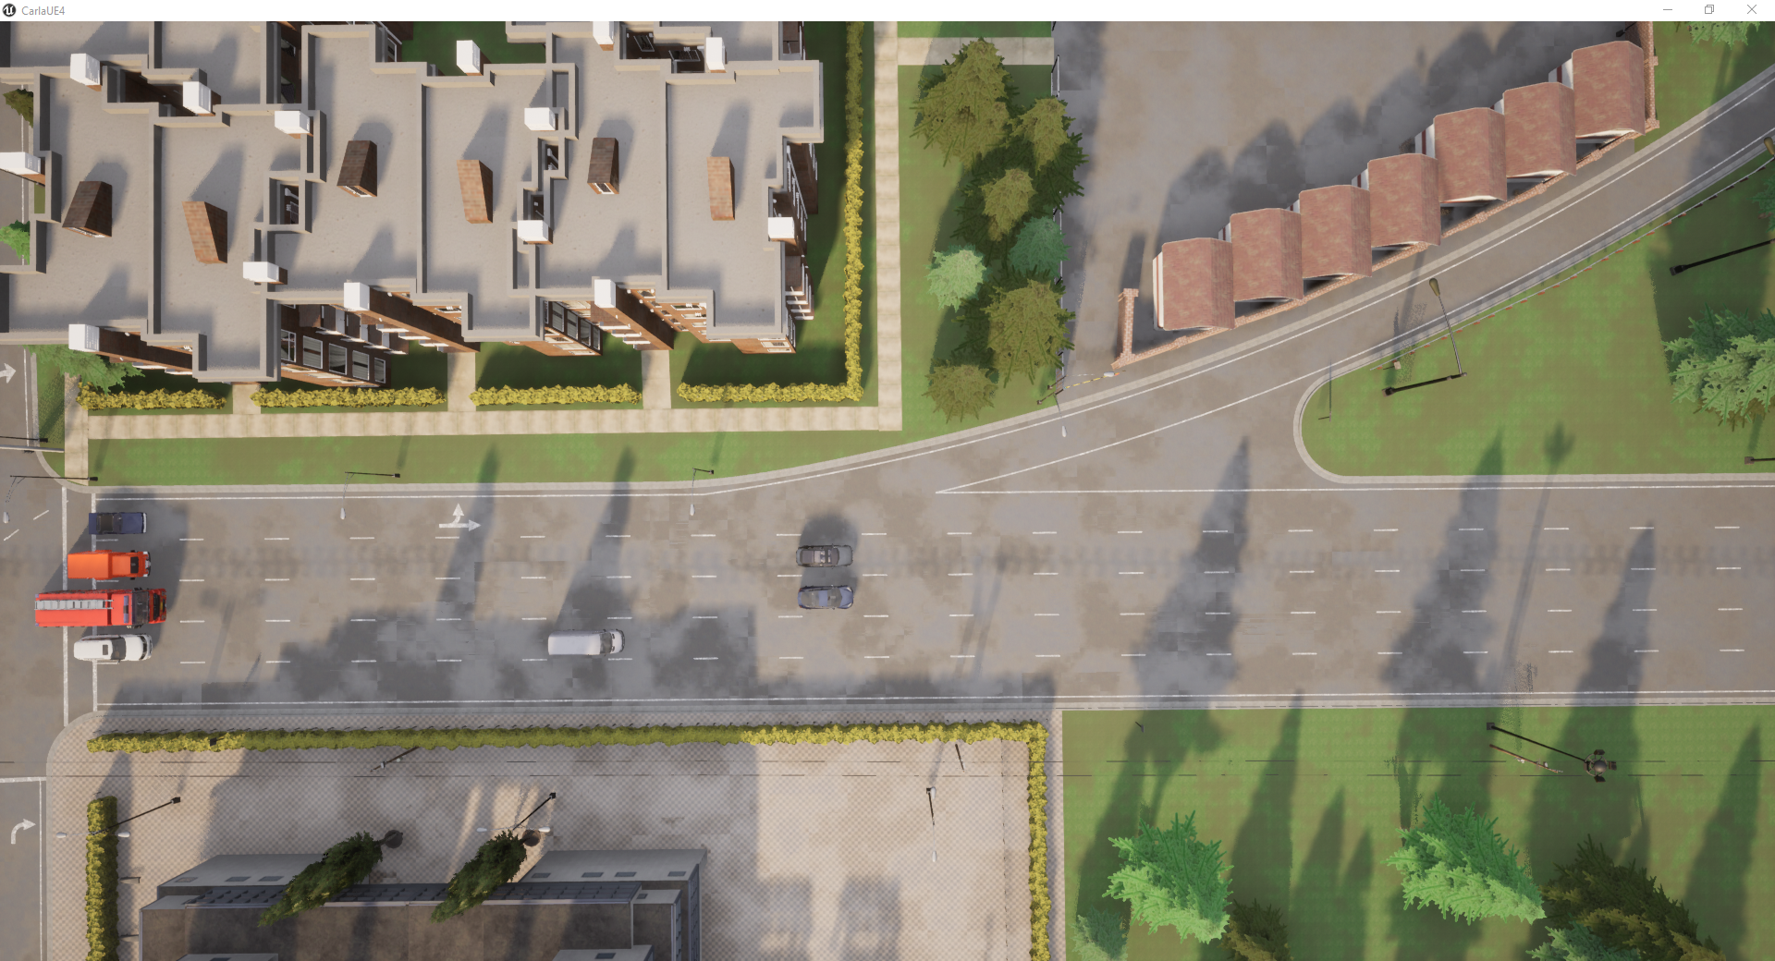
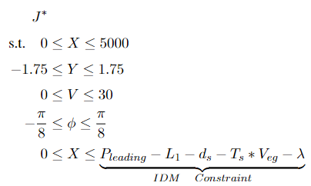
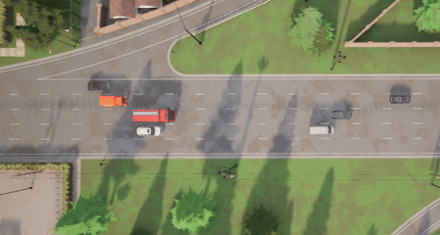
Adaptive Cruise Control
Tightened Bound with time (example)
Trailing controller
Initial Constraints
As time progresses, the constraints are increasingly tightened to mitigate noise effects (uncertainties between model and real vehicle). However, this is also more likely to lead to infeasible problem! Incorporating slack variables is necessary, but a high penalty needs to be given in the cost function.

Slide 5
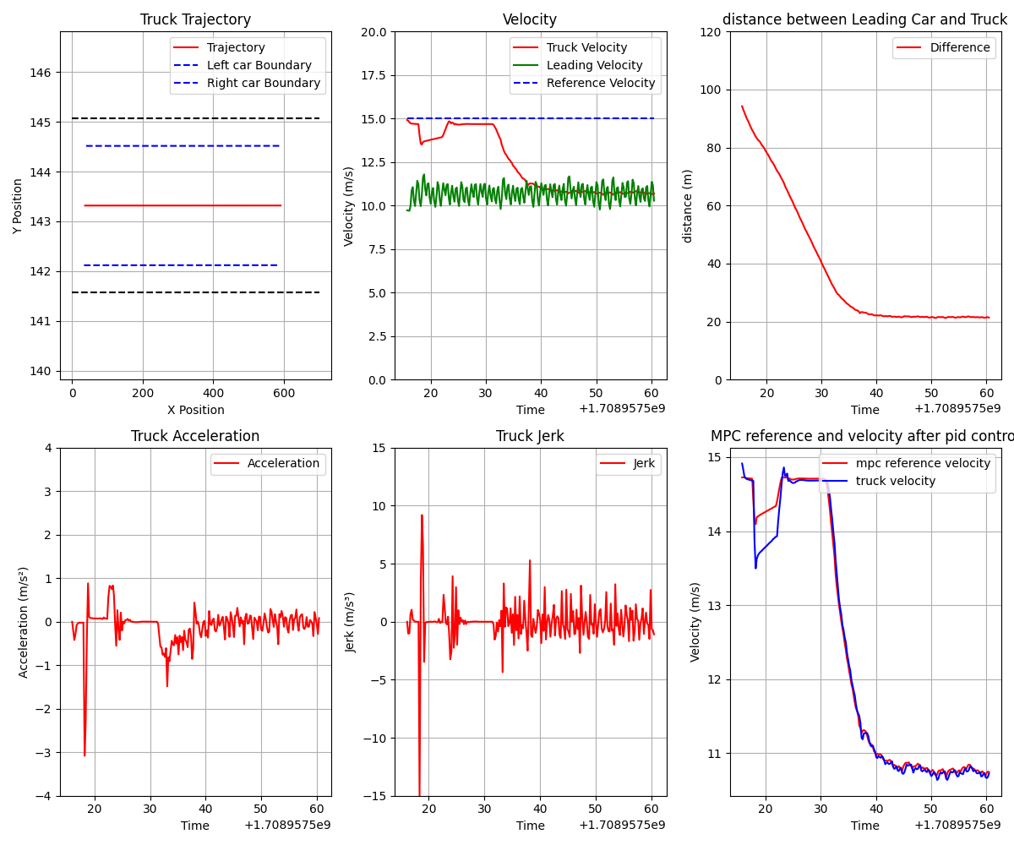

RMPC without EKF in trailing scenario
RMPC with EKF in trailing scenario

